Slide 1
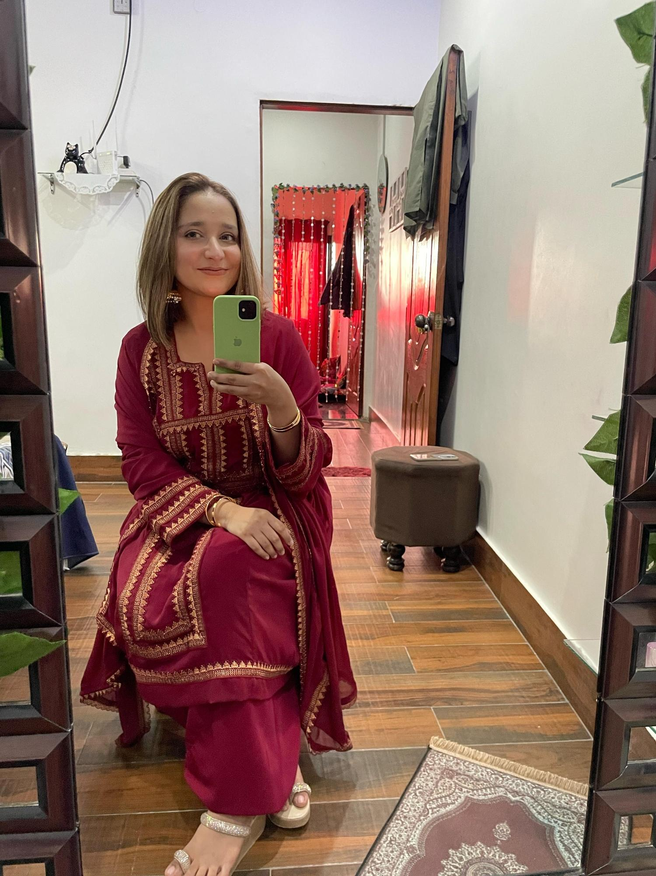
Danya Ali
Get ready to know about me

Slide 2
INTRODUCTION
Hello, me Danya, my graduation is about to complete in next couple of months and i want to do my master’s in ahead, i am always keen to up-skills myself by learning new things whenever i get a chance, i believe in being realistic, i love travelling

Slide 3
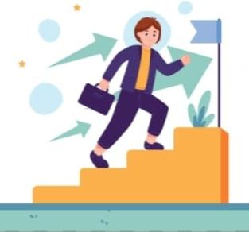
Personality Traits
Ambitious
Independent
Introverted
Loyal
Fearless
Expressive
Creative

Slide 4
Hobbies and interests
In my free time, I love to do Painting, Drawing and DIY Things, i am looking for new things to learn about it, I enjoy kdrama's alot ,I spend time for decor my home making DIY, my favourite ways to spend weekend is music, reading, eating and chilling ,cooking is my interest to love cooking for fam it’s a great way for me to express myself.
Things I do most...

Slide 5
I am a good student since my childhood I achieved positions, Receiving academic awards, Get full attendance certificate in school ,Gaining practical experience through seminars, Improving time management and team work, Participation in sports team also.
Academic / Personal
Achievements

Slide 6
Skilled learned in this course
The things I learned in this course MS Word, MS Excel, MS Power point , Programming ,Networking , Git and GitHub.

Slide 7
Favourite topic/tool
Role Model
My favourite topic is Music, my favourite singer is K-pop artist V he is a BTS member, also i love Bollywood song music heals me it makes my mood better guitar is my favourite tool and i want to learn to play it.
My mama is my role model she’s been my strength she a power woman she is the strongest person i know, For me she is the great example of how to live life to the fullest.

Slide 8
Future Goals
Strength/Weakness
Closing/Fun fact
My future goal is to pursue art i University learn different techniques, express my creativity, I hope to make a positive impact through my art. I want to do my master’s in art at a University.
My mama is weakness and also my strength whenever I feel low mama cheer me up alot .she makes my favourite dish and makes me feel much better.
I wish I could be a “SUPERWOMAN”
,so I could fly in the sky.
...THANKYOU...

